Slide 1
Prediction

Slide 2
Numeric prediction is the task of predicting continuous (or ordered) values for given input.
Eg. Predict the salary of college graduates with 10 years of work experience
The potential sales of a new product given its price
Most widely used approach for numeric prediction is regression, a statistical methodology that was developed by Sir Frances, a mathematician.
Regression analysis can be used to model the relationship between one or more independent or predictor variables and a dependent or response variable.

Slide 3
Regression
The predictor variables are the attributes of interest describing the tuple (i.e., making up the attribute vector).
The values of the predictor variables are known.
The response variable is what we want to predict—it is what we referred to as the predicted attribute.
Regression analysis is a good choice when all of the predictor variables are continuous valued.
Many problems can be solved by linear regression, and even more can be tackled by applying transformations to the variables so that a nonlinear problem can be converted to a linear one.
Several software packages exist to solve regression problems. Examples include SAS(www.sas.com), SPSS (www.spss.com), and S-Plus (www.insightful.com).

Slide 4
Linear Regression
Straight-line regression analysis involves a response variable, y, and a single predictor variable, x.
Simplest form of regression.
Models y as a linear function of x.
y = b+wx
where the variance of y is assumed to be constant
and b and w are regression coefficients specifying the Y-intercept and slope of the line.
The regression coefficients, w and b, can also be thought of as weights.
Equivalently written as y = w₀+w₁x
These coefficients can be solved for by the method of least squares.
It estimates the best-fitting straight line as the one that minimizes the error between the actual data and the estimate of the line.

Slide 5
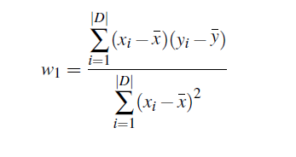

Let D be a training set consisting of values of predictor variable, x, for some population and their associated values for response variable, y.
The training set contains |D| data points of the form(x₁, y₁), (x₂, y₂), …, (x_{|D|}, y_{|D|})
The regression coefficients can be estimated
where is the mean value of x₁, x₂, . . . , x_{|D|,} and is the mean value of y₁, y₂, . . . , y_{|D|.}

Slide 6
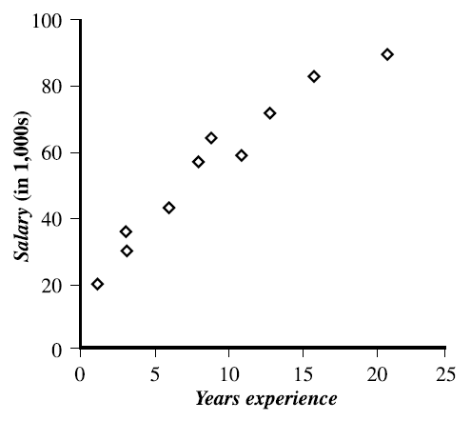
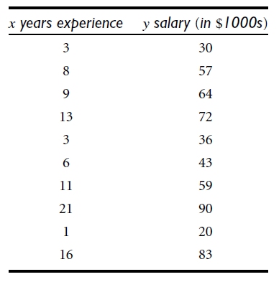
Example

Slide 7
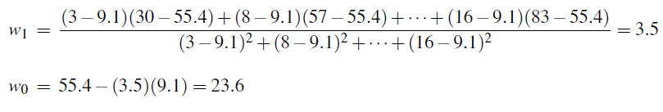
y = 23.6+3.5x
Can predict that the salary of a college graduate with 10 years of experience is $58,600.
Multiple linear regression -Involve more than one predictor variable
y = w₀+w₁x₁+w₂x₂

Slide 8

Multiple linear regression
Multiple linear regression is an extension of straight-line regression.
Involve more than one predictor variable.
Response variable y to be modeled as a linear function of n predictor variables or attributes, A₁, A₂, . . . , A_{n}, describing a tuple, X. (That is, X = (x₁, x₂, . . . , x_{n}).)
Training data set, D, contains data of the form (X₁, y₁), (X₂, y₂), . . . , (X_{|D|}, y_{|D|}), where the X_{i} are the n-dimensional training tuples with associated class labels, yi.
Eg: multiple linear regression model based on two predictor attributes or variables, A1 and A2, is
where x1 and x2 are the values of attributes A1 and A2, respectively, in X.
The method of least squares can be extended to solve for w0, w1, and w2.
The equations, however, become long and are tedious to solve by hand.
Multiple regression problems are commonly solved with the use of statistical software packages, such as SAS, SPSS, and S-Plus.

Slide 9
Nonlinear Regression
Model the data that does not show a linear dependence.
Response variable and predictor variable have a relationship that may be modeled by a polynomial function.
Polynomial regression - when there is just one predictor variable.
Modeled by adding polynomial terms to the basic linear model.
Apply transformations to the variables and convert the nonlinear model into a linear one.

Slide 10
Transformation of a polynomial regression model to a linear regression model
Consider a cubic polynomial relationship given by
To convert this equation to linear form, we define new variables:
x₁ = x x₂ = x² x₃ = x³
y = w₀ +w₁x₁ +w₂x₂ +w₃x₃
which is easily solved by the method of least squares using software for regression analysis.
Polynomial regression is a special case of multiple regression
y = w₀+w₁x+w₂x²+w₃x³

Slide 11
Some models are intractably nonlinear and cannot be converted to a linear model.
For such cases, obtain least square estimates through extensive calculations on more complex formulae.
Various statistical measures exist for determining how well the proposed model can predict y.
The greater the number of predictor attributes is, the slower the performance is.
Before applying regression analysis, perform attribute subset selection to eliminate attributes that are unlikely to be good predictors for y.
In general, regression analysis is accurate for prediction, except when the data contain outliers.

Slide 12
Other Regression-Based Methods
Generalized linear models - linear regression is applied to the modeling of categorical response variables.
The variance of the response variable, y, is a function of the mean value of y, unlike in linear regression, where the variance of y is constant.
Types of generalized linear models –
Logistic regression – Models probability of some event occurring as a linear function of a set of predictor variables
Poisson regression- Count data frequently exhibit a Poisson distribution

Slide 13
Log-linear models
Approximate discrete multidimensional probability distributions
used to estimate the probability value associated with data cube cells
Eg. city, item, year, and sales
Requires all attributes to be categorical
continuous-valued attributes must first be discretized.
estimate the probability of each cell in the 4-D base cuboid for the given attributes, based on the 2-D cuboids for city and item, city and year, city and sales, and the 3-D cuboid for item, year, and sales.

Slide 14
Decision tree induction can be adapted so as to predict continuous (ordered) values, rather than class labels.
Types of trees for prediction—regression trees and model trees.
Regression trees
Component of the CART (Classification and Regression Trees) learning system
Each regression tree leaf stores a continuous-valued prediction, which is actually the average value of the predicted attribute for the training tuples that reach the leaf.
Model trees
Each leaf holds a regression model—a multivariate linear equation for the predicted attribute

